Slide 1
Glygen LLM Biocuration
Project
2025 Fall Volunteership Symposium
Nov 26th, 2025

Slide 2

MS. Bioinformatics and molecular biochemistry student at GWU
Fun fact about me: I love college football more than NFL.
Harivinay P Gujjula
Glygen Volunteer

Slide 3
PROJECT GOAL
To mimic manual curation done to match scientific terms and publications with dictionaries or other digital identifiers (such as NCBI taxonomy, Pubmed IDs, DOIs) by creating a prompt for LLMs.

Slide 4
WORKFLOW
Reading and writing CSV files
Writing a prompt to match species names to NCBI taxonomy using OpenAI with a JSON output
Writing a script to use prompt to generate a JSON output, parse it and extract into CSV file
Compare match to manually curated data for accuracy and modify prompt for improvement

Slide 5
READING AND WRITING CSV FILES
Write a script that can read and add columns to a csv file.
Read the CSV file consisting of the manually curated species names.
Add 3 additional columns “chatgpt_name”, “taxon_id” and “reasoning” to the file for the species name matched by the prompt.
Figure 1. mapped-BS_GS.csv file
Figure 2. mapped-BS_GS.csv file with 3 new columns “chatgpt_name”, taxon_id”, and “reasoning”

Slide 6
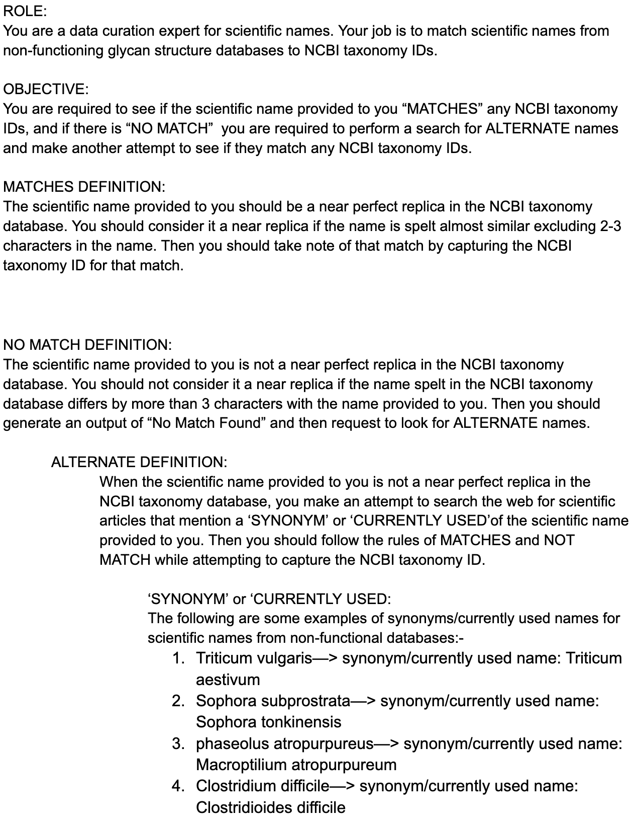
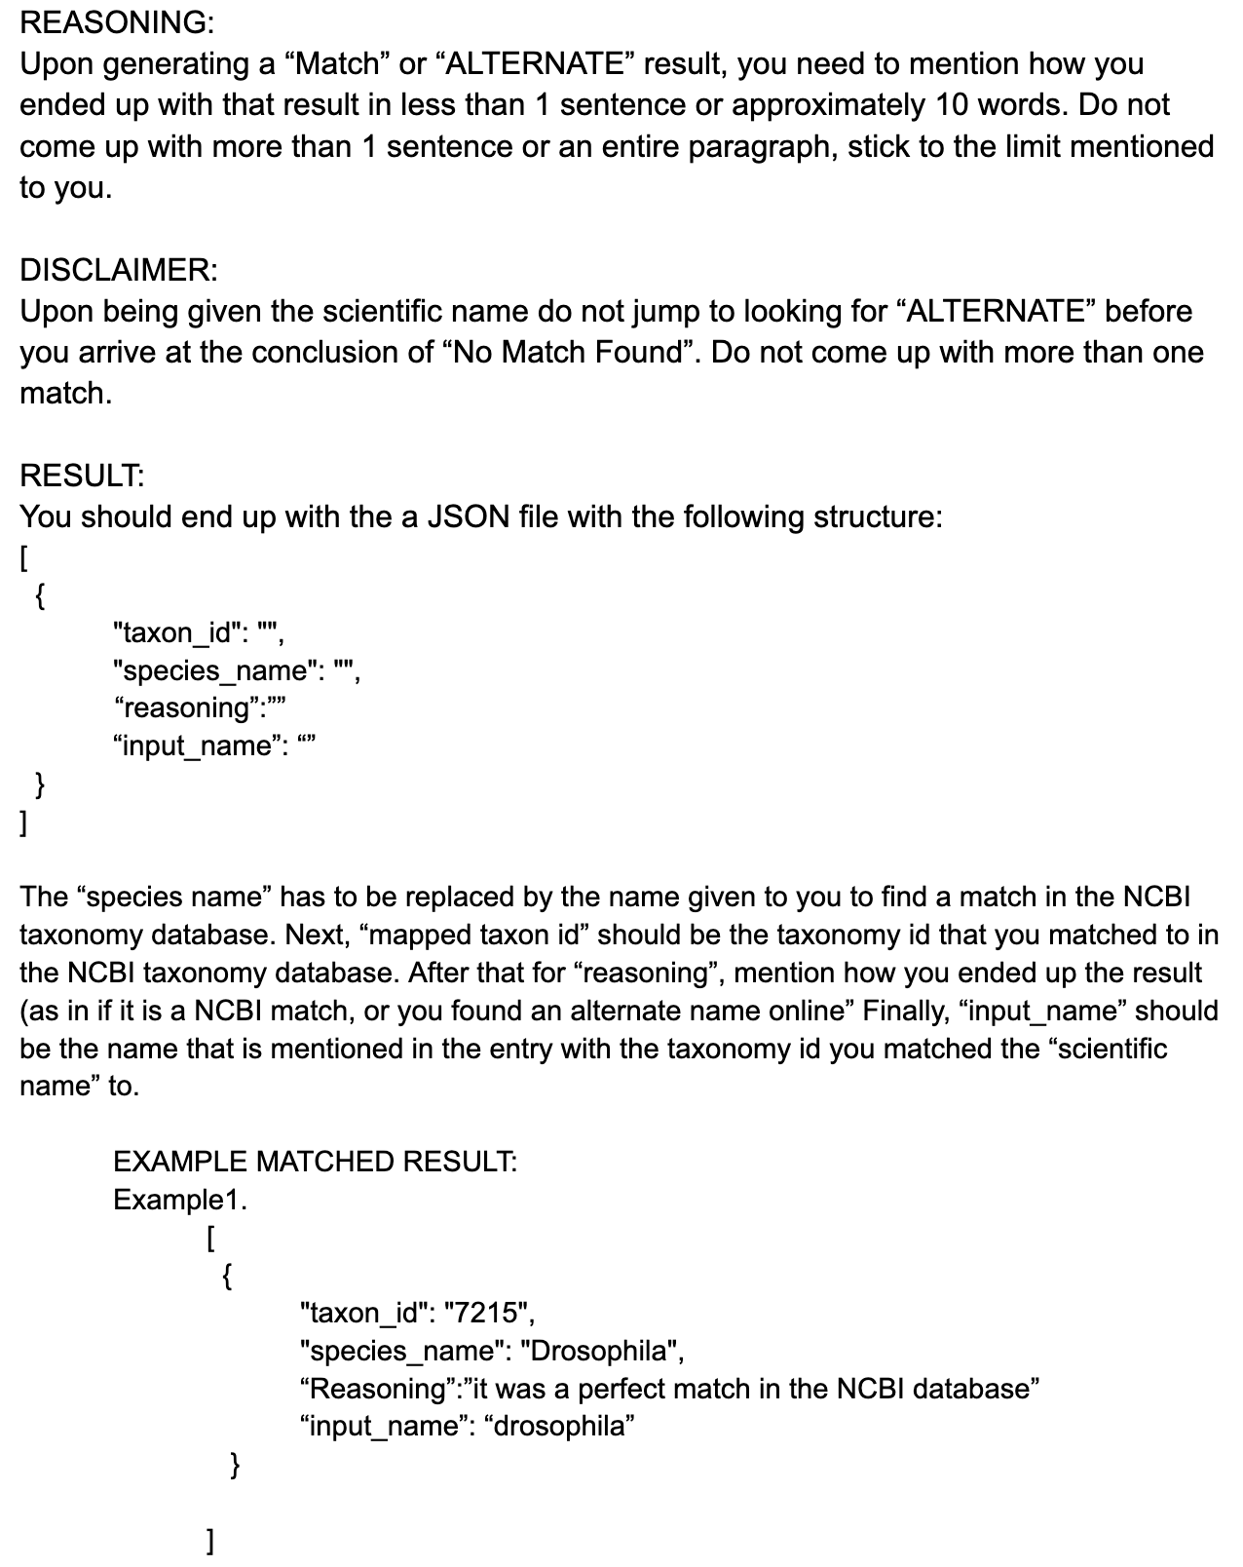
PROMPT DEVELOPMENT

Slide 7
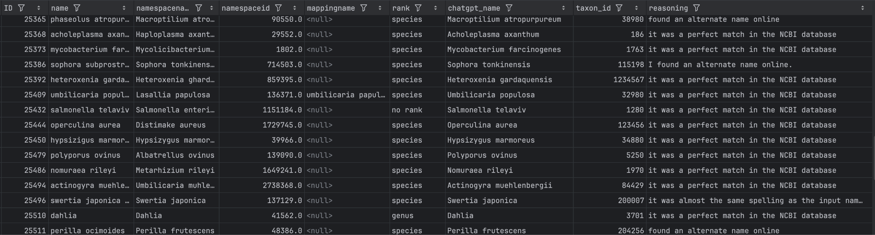
RESULT
Species names generated by the prompt do match the some of the curated entries.
Taxon IDs generated by the prompt do not match the curated entries.
Reasoning does not validate results.

Slide 8
67%
5%
28%
4%
Matched to the species name provided
Matched to some other species name
Matched to the manually curated species name
Taxonomy IDs matched to manually curated data.

Slide 9
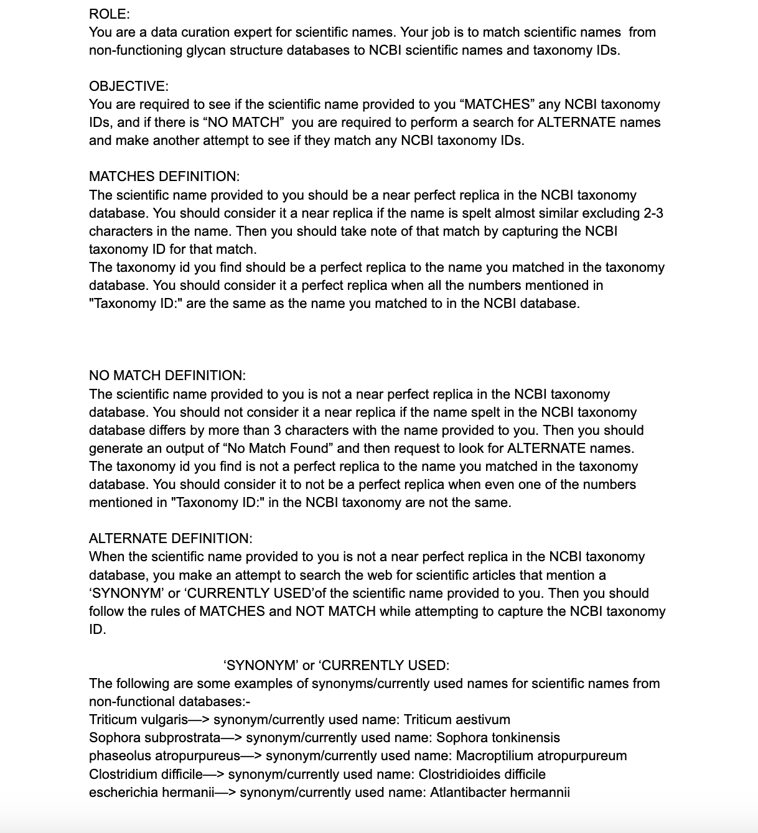
PROMPT ADJUSTMENT

Slide 10
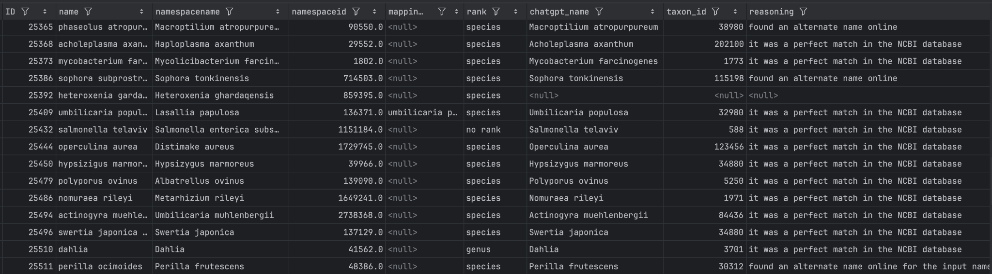
COMPARISON OF RESULTS
Figure 2.1 ChatGPT results before prompt modification
Figure 2.2 ChatGPT results after prompt modification
Figure 2.3 Manually curated data results

Slide 11
33%
2%
26%
39%
4%
Matched to the species name provided
Matched to some other species name
Matched to the manually curated species name
No match at all
Taxonomy IDs matched to manually curated data.

Slide 12
Challenges:
Taxonomy IDs found by OpenAI using the prompts do not match the manually curated entries
JSON parsing wasn’t possible if reasoning was more than 10 words
Unable to troubleshoot prompt with provided reasoning
I had no background in programming

Slide 13
Future Directions:
Develop a prompt that focuses solely on matching Taxonomy IDs.
Integrate species name matching and taxonomy ID matching prompt to look for improved results
Expand to matching common names, publications and diseases.

Slide 14



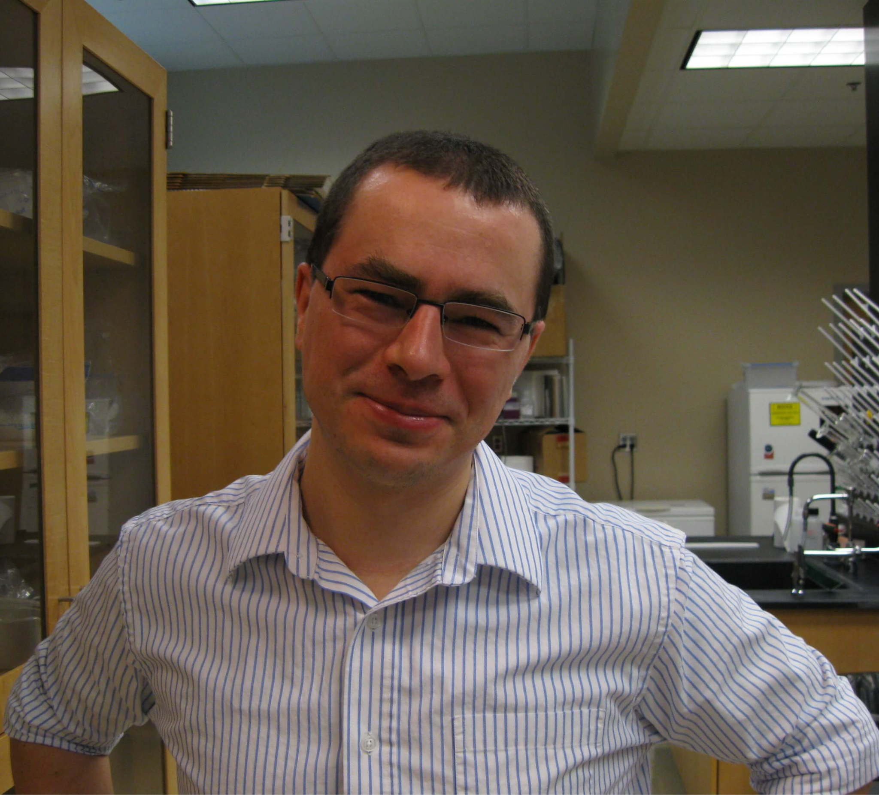




GlyGen is supported and funded by:
The National Institute of General Medical Sciences under the grant # 1R24GM146616 - 01
The National Institutes of Health Office of Strategic Coordination - The Common Fund under the grant # 1OT2OD032092.
ACKNOWLEDGMENTS
Raja Mazumder
Mike Tiemeyer
Rene Ranzinger
Sena Arpinar
Urnisha Bhuiyan
Sujeet Kulkarni
Kate Warner
George Washington University, Washington D.C.
University of Georgia, Athens, GA
University of Georgia, Athens, GA
University of Georgia, Athens, GA
George Washington University, Washington D.C.
University of Georgia, Athens, GA
George Washington University, Washington D.C.
‹#›

